Slide 1
f?

Slide 2
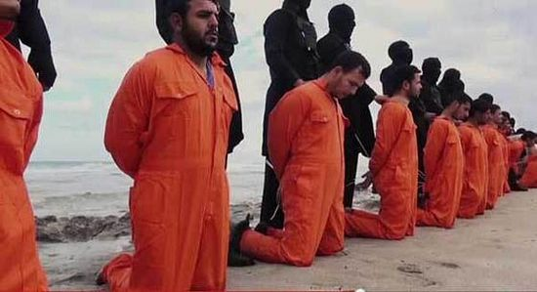
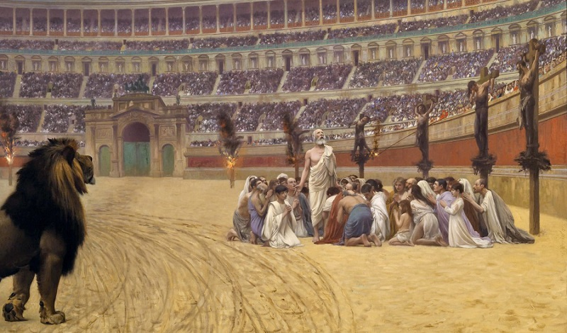
Christians are to pitied more than all if…

Slide 3
Biblical Mandate and Examples
The wrath of God is being revealed from heaven against all the godlessness and wickedness of men who suppress the truth by their wickedness, since what may be known about God is plain to them, because God has made it plain to them. For since the creation of the world God's invisible qualities--his eternal power and divine nature--have been clearly seen, being understood from what has been made, so that men are without excuse (anapologaetous) (Romans 1:18-20).

Slide 4
Called to Defend

Slide 5
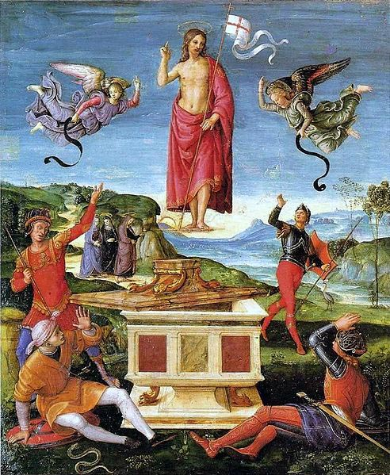
Not Cleverly Invented Stories

Slide 6
A Ministry of Caring

Slide 7
f?

Slide 8
Tactics and Advice

Slide 9
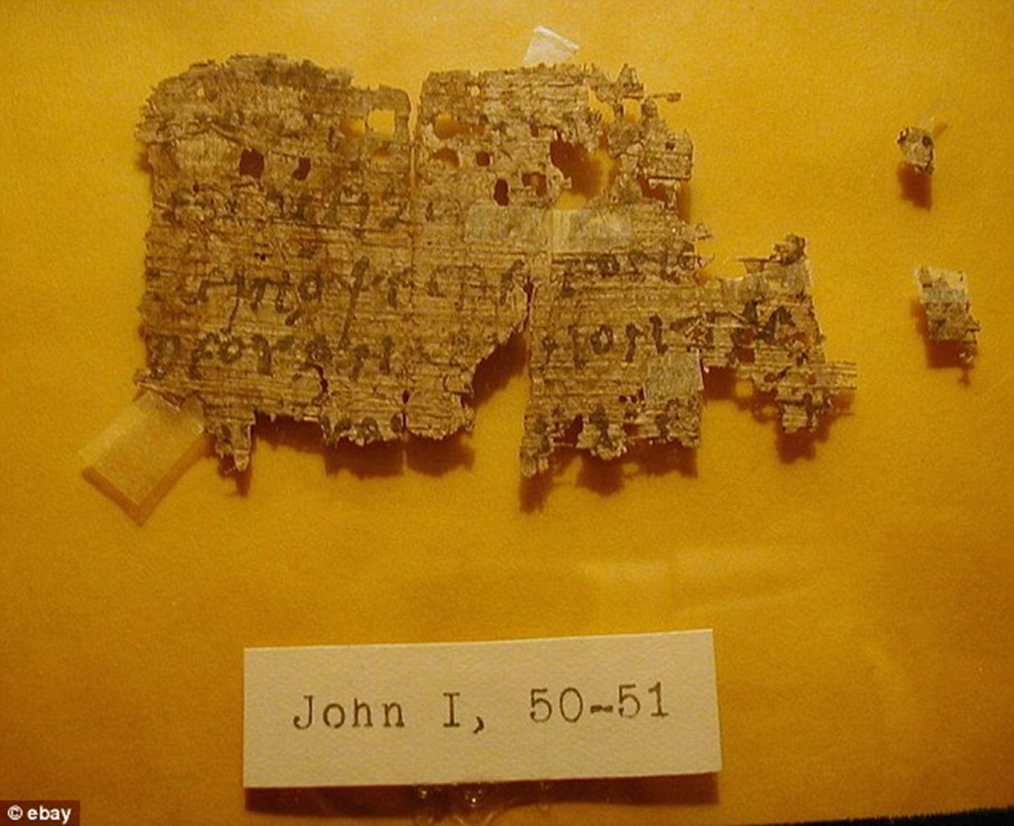
Judging the New Testament Texts & Prophecy

Slide 10
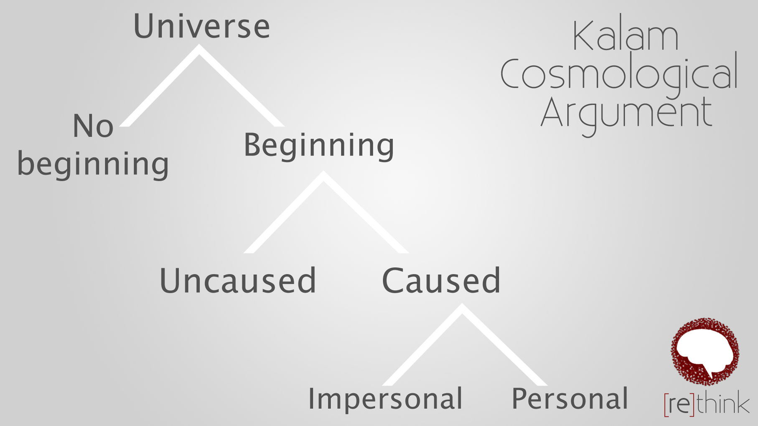
Cosmology and Teleology

Slide 11
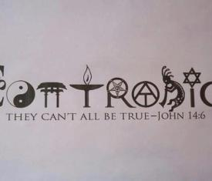
Truth

Slide 12
The Moral Argument for God

Slide 13
The Soul

Slide 14
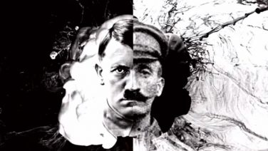
The Problem of Evil

Slide 15
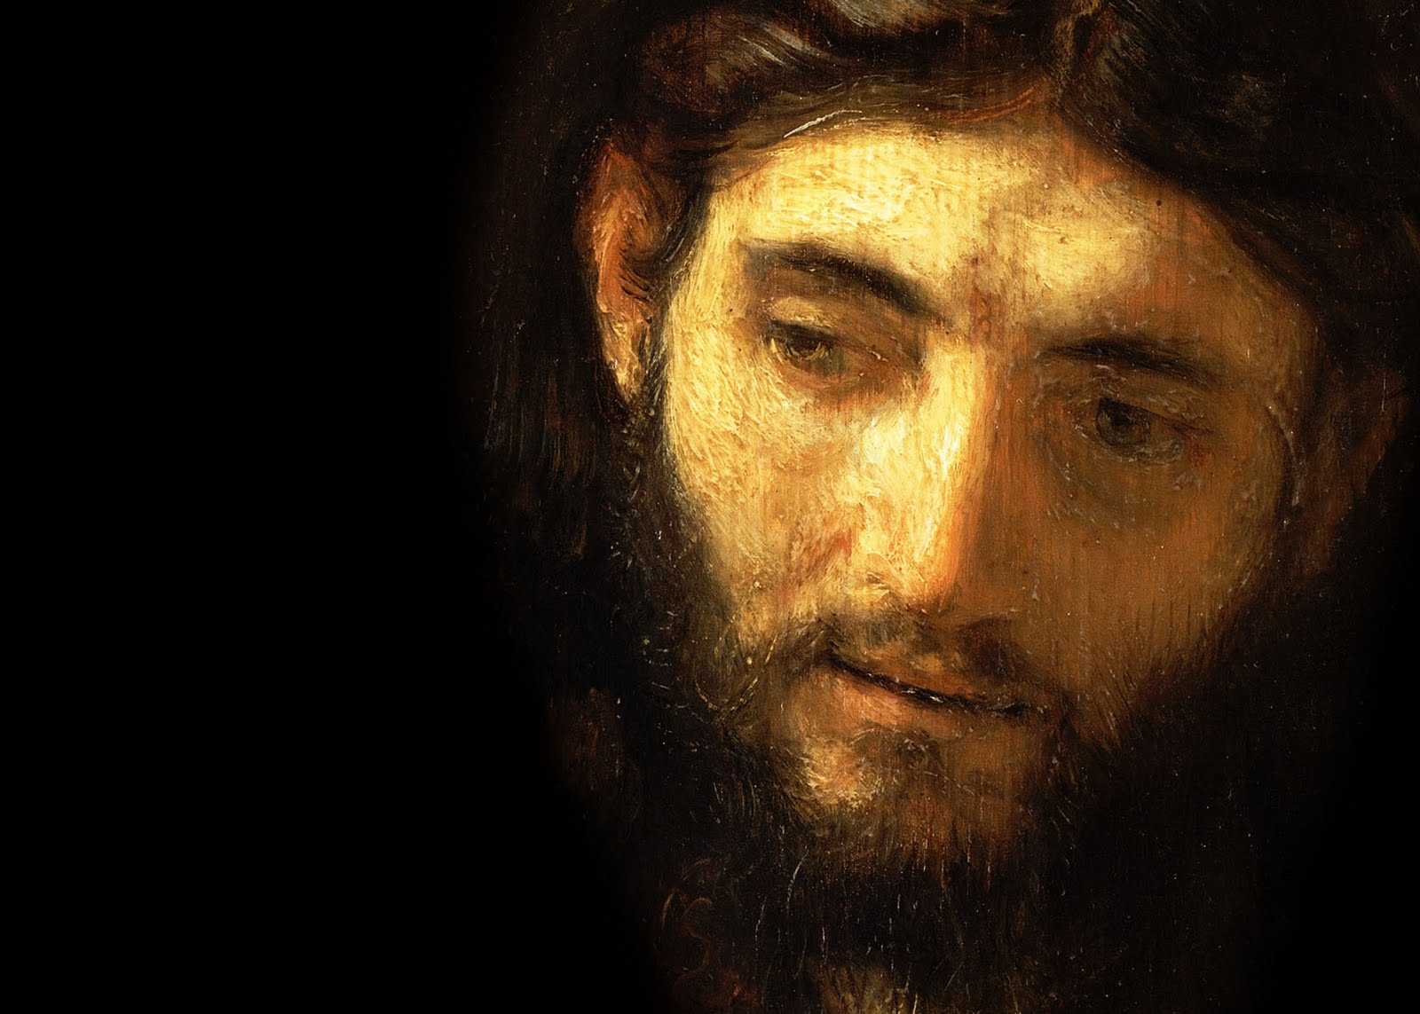
You have to do something with this Jesus fellow.

