Slide 1
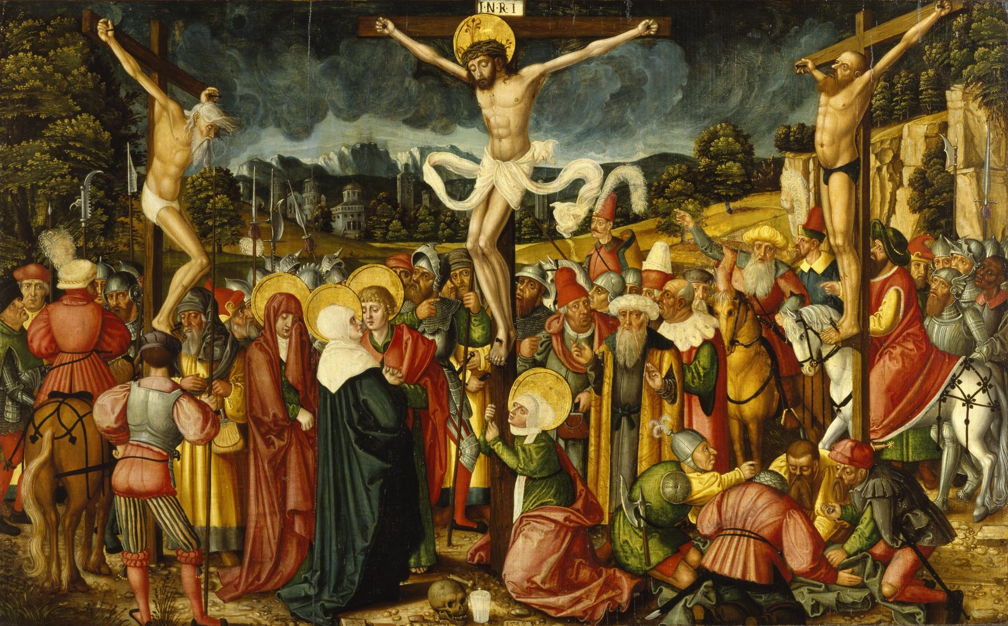
Built to Serve
You, my brothers and sisters, were called to be free. But do not use your freedom to indulge the flesh rather, serve one another humbly in love.
Galatians 5:13

Slide 2
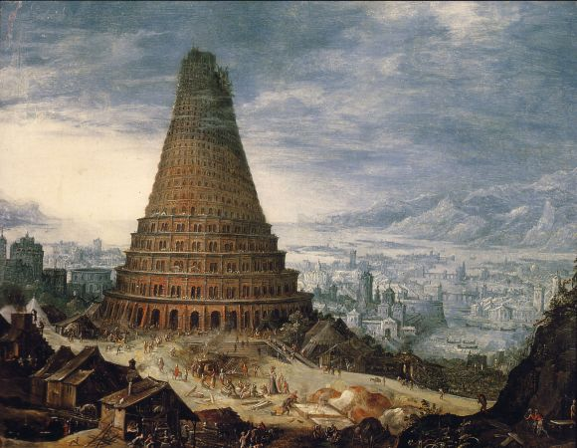
Human Potential

Slide 3
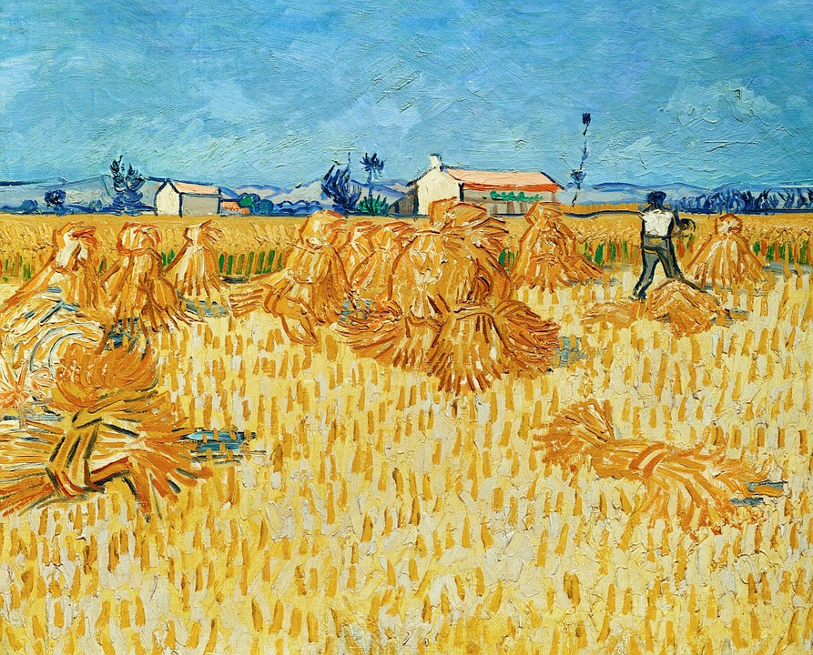
Vocation as the Setting for Spiritual Warfare: Calling

Slide 4
True
Freedom
in
Justification

Slide 5
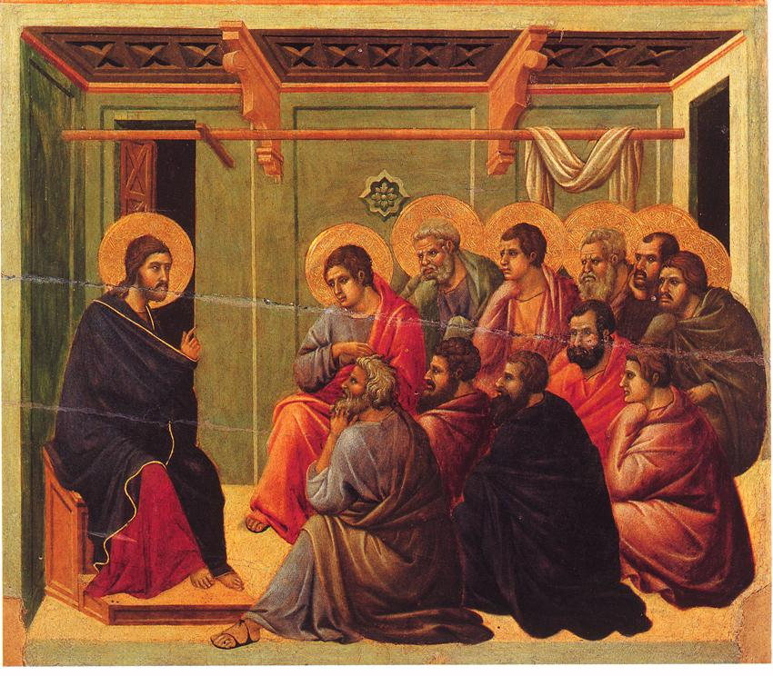
An Ethical Reorientation

Slide 6
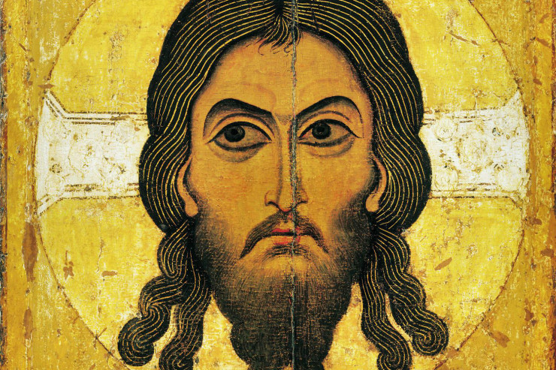
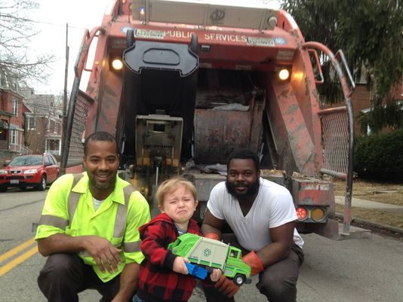
Vocation as Setting for Sanctification:
To a Startling Degree

Slide 7
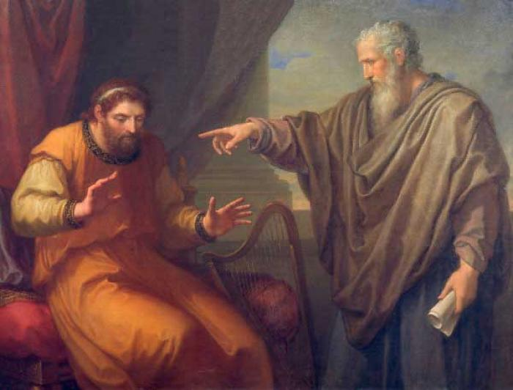
Sinning against Vocation

Slide 8
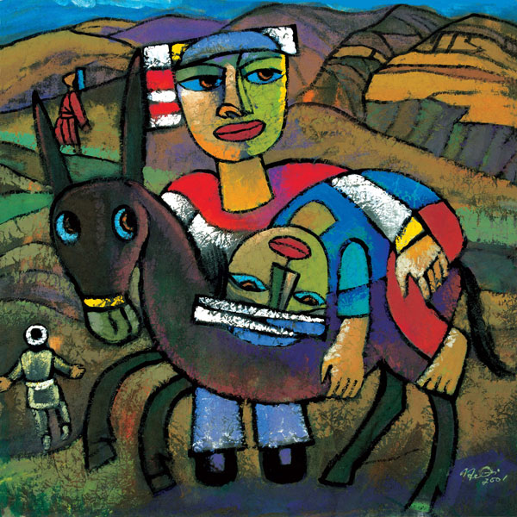
Masks of God

Slide 9
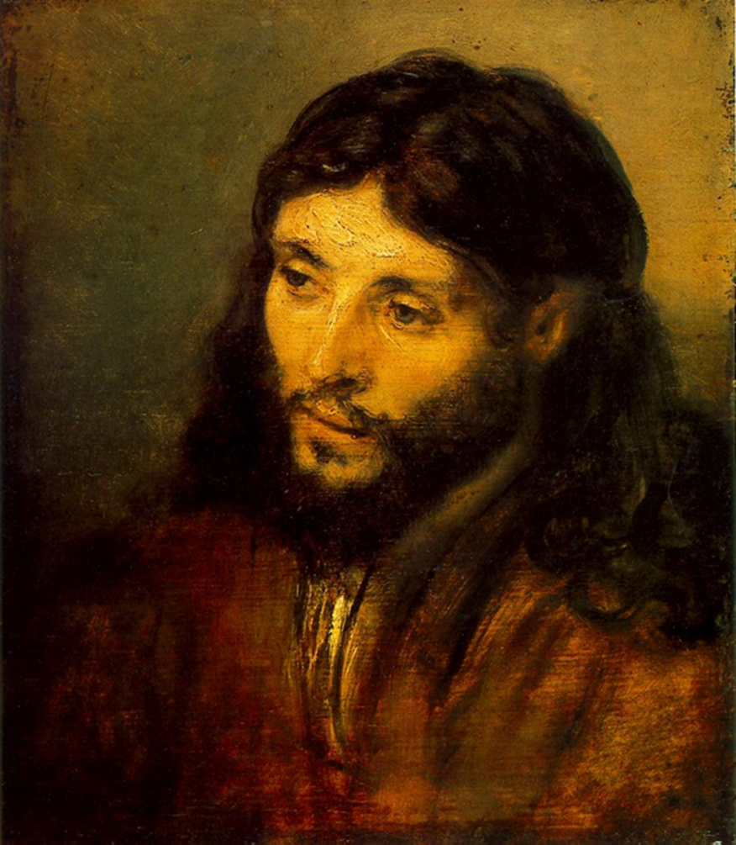
Vocation as the Setting for Purpose:
A Christological Endeavor

Slide 10
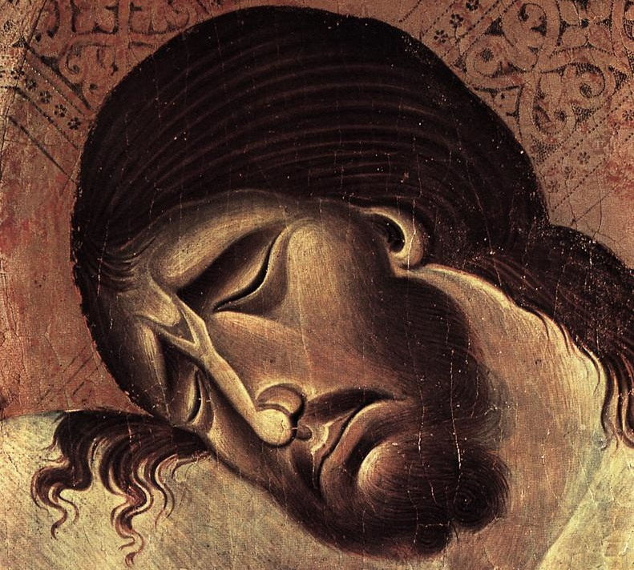
Human Dignity

Slide 11
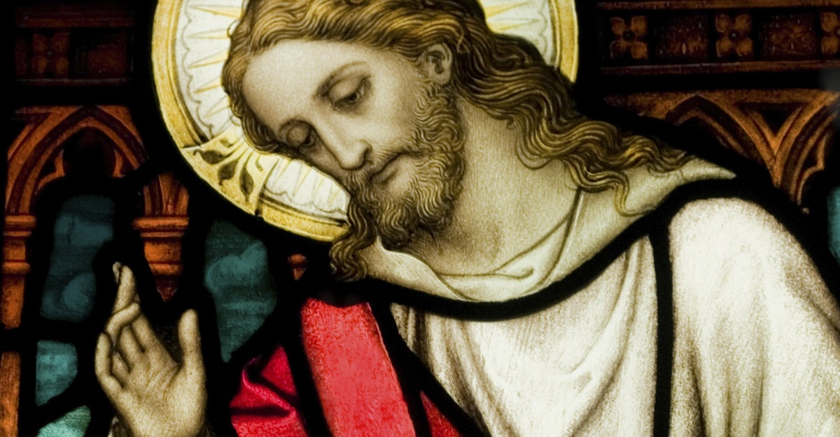
True Self-Esteem

Slide 12
Vocation as the Setting for a Wider Liberality:
Neomonasticism

Slide 13
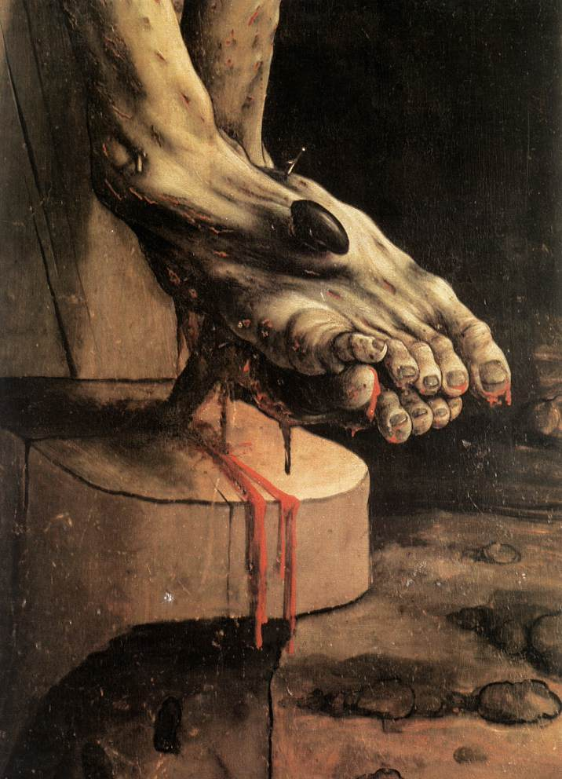
Love Knows
No Program

Slide 14
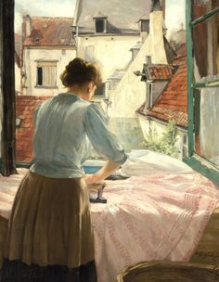
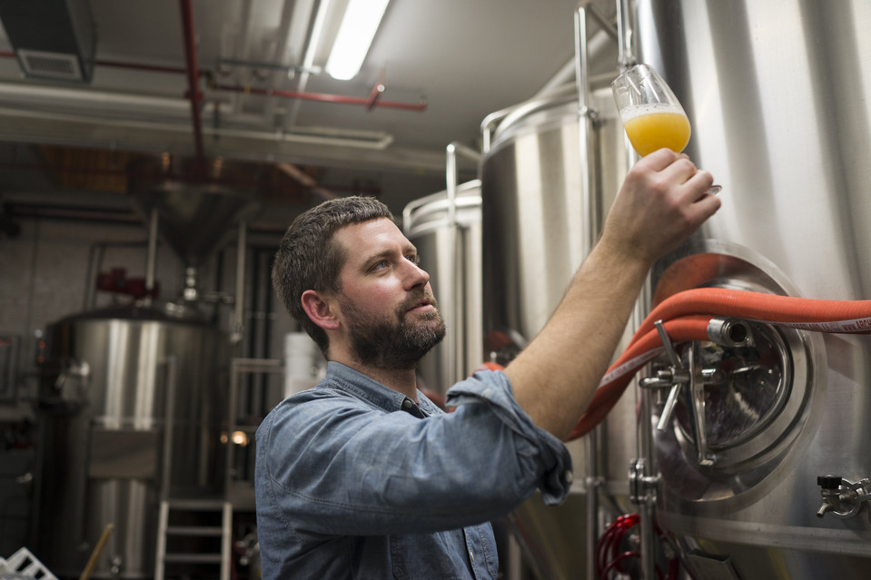
Losing Oneself in a Craft

Slide 15
Vocation as the Setting for Shalom:
Virtue for the Sake of Virtue

Slide 16
The Pursuit of Eudaimonia

Slide 17
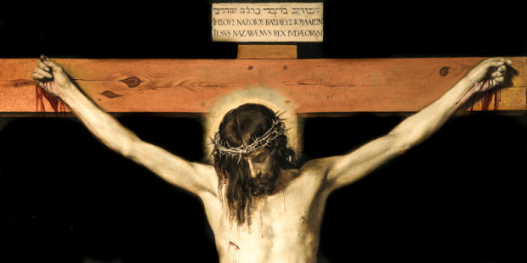
A Hidden God

Slide 18
Vocation as the Setting for Evangelism

